Slide 1
Chest X-Ray Radiology Reports Generation with Pre-trained CLIP Model
20161112 Jungmin Park
20181257 Chanhyeok Choi
20201272 Dami Jung
Notes:
Upto 7 slides, 5 min presentation and 1 min Q&A
Methods and approach 1p, Specification 3p (dataset, model architecture, evaluation methods each)

Slide 2
CONTENTS
01.
02.
03.
04.
Introduction
& Contribution
Method
& Approach
Results
Conclusion
& Discussion
Introduction
Contribution
Related work
Limitation and key idea
Methods
Model architecture
Dataset
Evaluation
Comparison with original model
Conclusion
Limitation
Future work

Slide 3
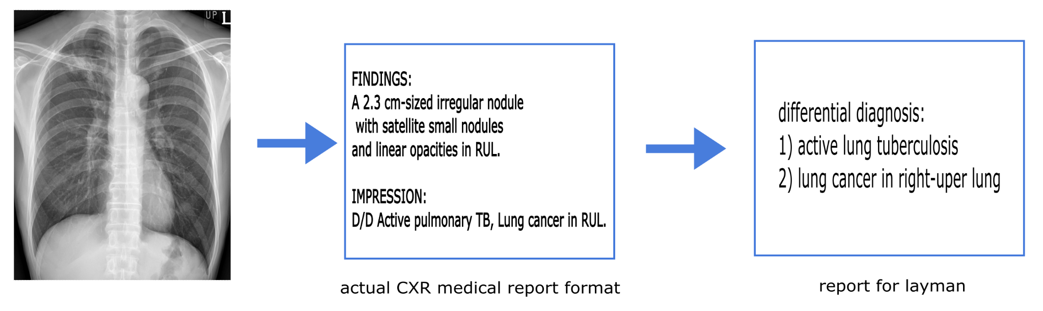
Introduction
& Contribution
Automated radiology report generation
→ Potentially improve radiology reporting and alleviate the workload of radiologists
→ “Laypeople” users can also access the radiology report generated by the model
Apply different loss & encoder
Compare results with previous research
Idea for simplification of medical report
Notes:
레포트의 fig4 화질 수정해서 넣기
Automated radiology report generation can potentially improve radiology reporting and alleviate the workload of radiologists. Research on a model that prepares a radiation report by training chest X-ray images is in progress, such as using weakly supervised contrastive loss for medical report generation (Yan et al., 2021 \hyperlink{[1]}{[1]}) or adapting CLIP-based models to the the chest x-ray classification and generating images from text (Wiehe et al., 2022 \hyperlink{[2]}{[2]}). However, report generated from previous models still not guarantee good predictions for rare pathology and not very readable for general public. In this project, we focus on developing our own model using nontrivial methods and improve a prior method in order for automated report generation deployment to advance patient care. In addition, we're proposing an idea as future work for text simplification on generated report to re-generate simple and easy-to-understand contents for laypeople.

Slide 4
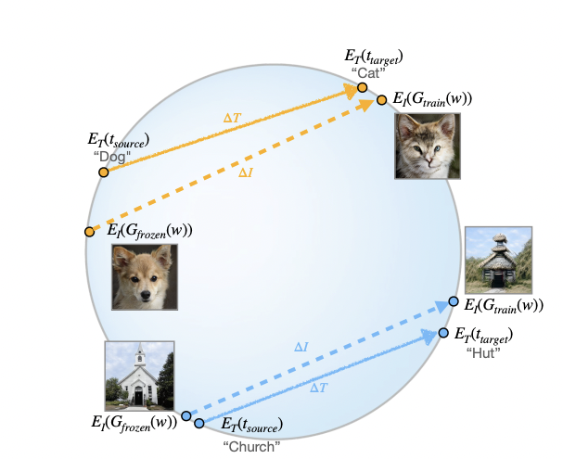
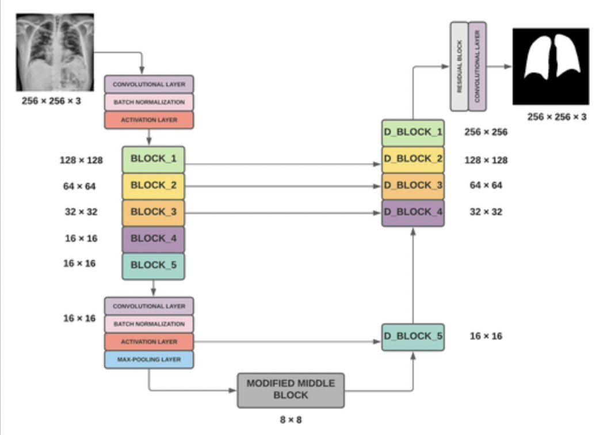
Related Work
Chest X-Ray Report Generation from Chest-X Ray Images (Haritaoglu et al., 2020)
StyleGAN-NADA: CLIP-Guided Domain Adaptation of Image Generators (Gal et al., 2021)
EfficientUNet: Modified encoder-decoder architecture for the lung segmentation in chest x-ray images
(Agrawal et al., 2022)
Key ideas !
Embed images generated by both generators into CLIP-space
→ Demand vector connecting them(∆I) is parallel to the vector connecting a source and target text(∆T)
Generation-based approach
Pretrained UNet image encoder
Cross Entropy Loss at the output of the text decoder
Try advanced pre-trained UNet (EfficientNet-B4) image encoder
CLIP (pre-trained Contrastive Language-Image) in contrastive loss
Use IU X-ray(lateral and frontal), CLIP model trained with MIMIC-CXR
Use dice coefficient loss and EfficientUNet
Evaluated on the lungs that are highly irregular in shape and size due to different pulmonary abnormalities
Limitation & Idea
Cannot make predictions for rare pathologies
Not very readable with medical jargon and generally long sentences
Limitation & Idea
Limitation & Idea
Apply CLIP directional loss to transformer decoder
Compare the performance of ResNet and EfficientUNet in generating report
Notes:
In Endo et al., 2021 \hyperlink{[6]}{[6]}, the baseline approach of a contrastive language image model (CLIP) trained on radiology report-image pairs showed good performance across overall evaluations. However, it is only applied to retrieval-based generation method.

Slide 5
Methods and Approach
01.
Modified pre-trained EfficientNet-B4
02.
Apply CLIP as loss function
Replacement with pretrained EfficientUNet encoder and compare the performance
Improved performance with the new Loss function with CLIP model

Slide 6
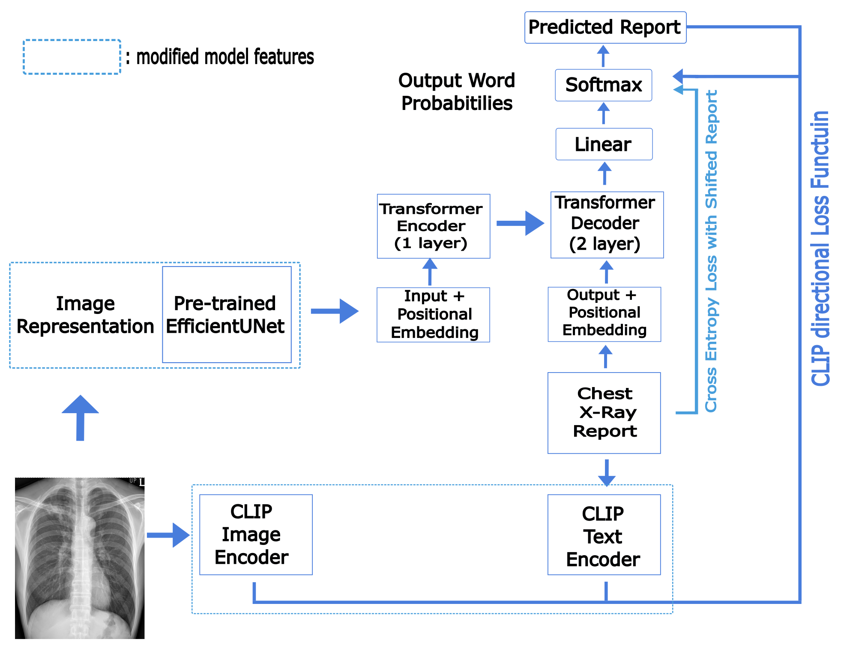
Model architecture
Image encoder
EfficientNet-B4 pre-trained on ImageNet dataset
- Efficient architecture for accurate lung segmentation in chest x-rays
- Pre-trained encoder, and decoder uses residual learning and batch normalization to improve the performance
Loss function
Improved performance with the new directional Loss function with CLIP model
CLIP directional loss function with pre-trained CLIP model to transformer decoder
Notes:
모델 그림 수정

Slide 7
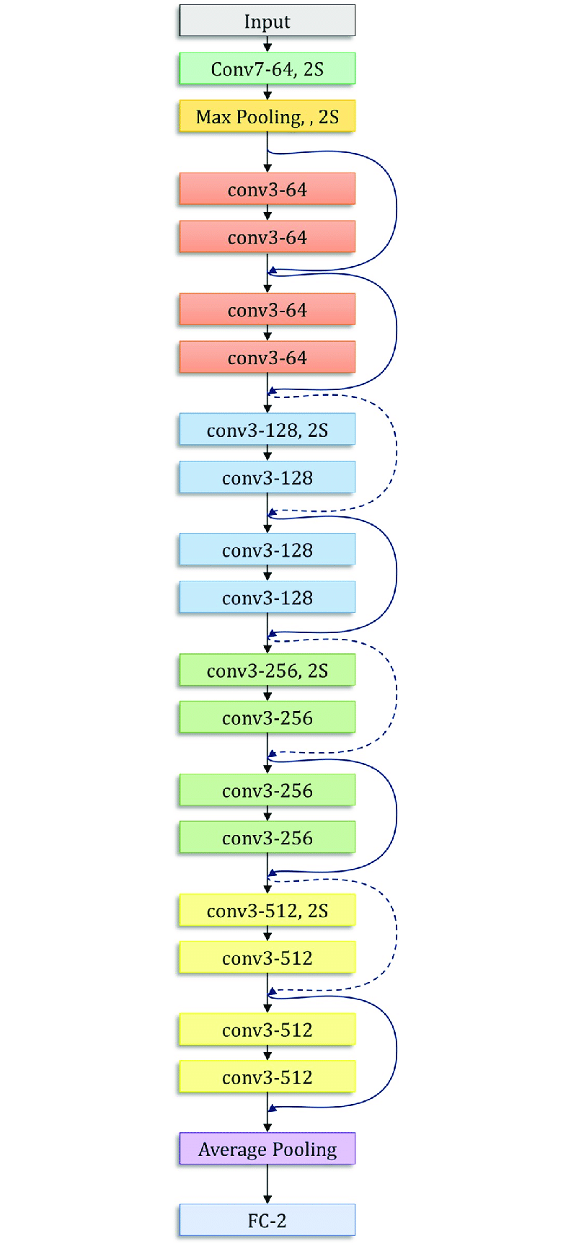
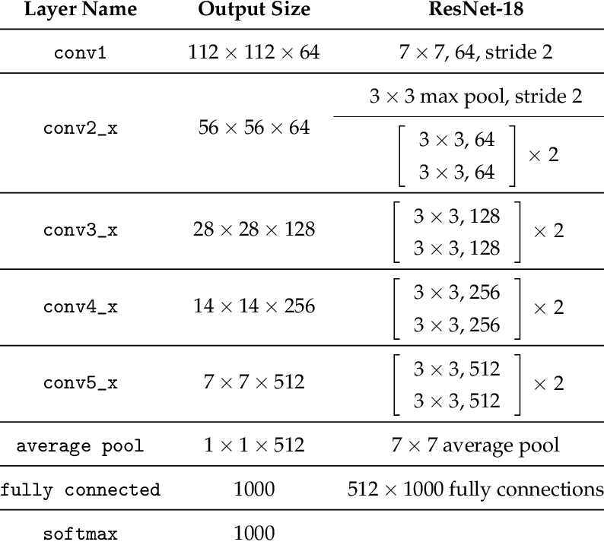
Detail - ResNet 18
ResNet with 18 layers
Layers get deep, poor performance
Vanishing gradient
Use skip connection!
→ solve vanishing gradient
Better for image classification
Notes:
그림 레퍼런스

Slide 8
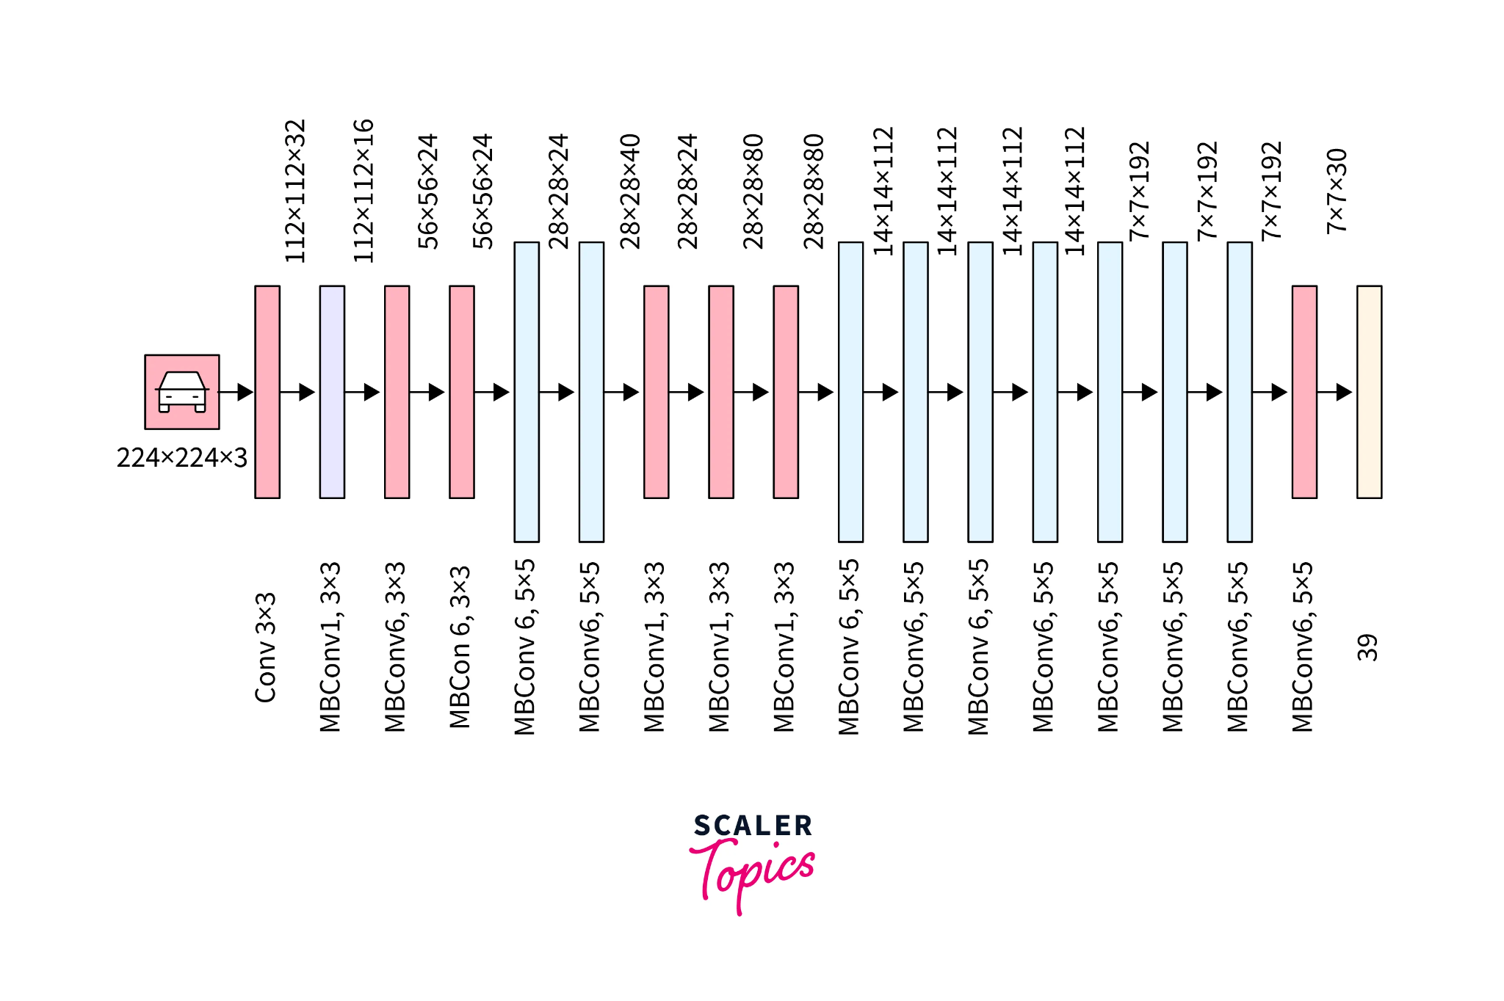
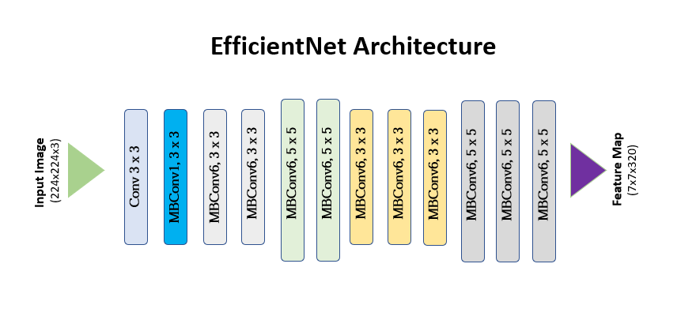
Detail - EfficientNet-B4
Convolutional neural network architecture and scaling method
Uniformly scales all dimensions of depth/width/resolution using a compound coefficient
Has better performance than other popular transfer learning networks such as ResNet-50, Inception-v4, and MobileNet-v2
Notes:
Change picture, add comment

Slide 9
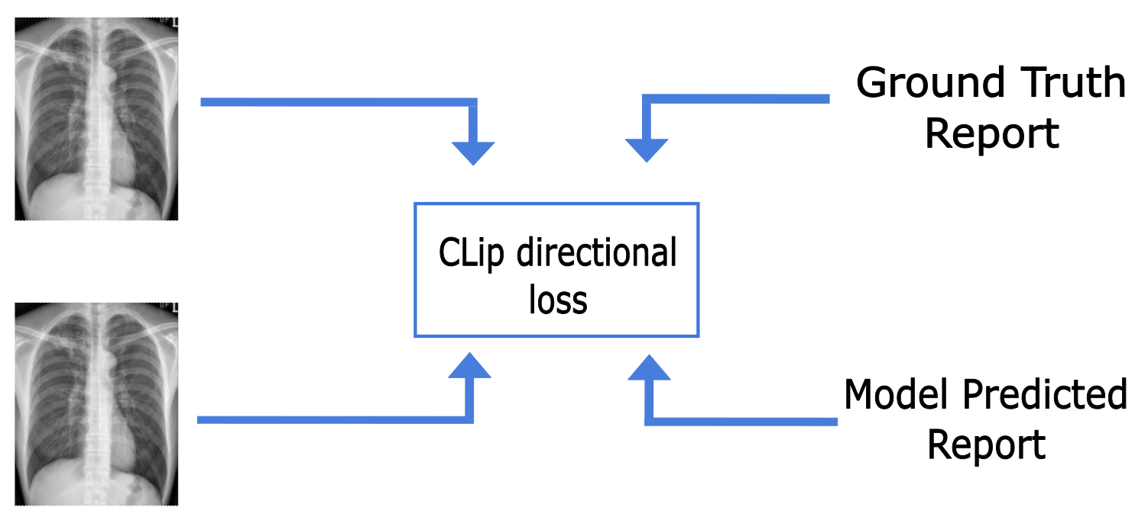
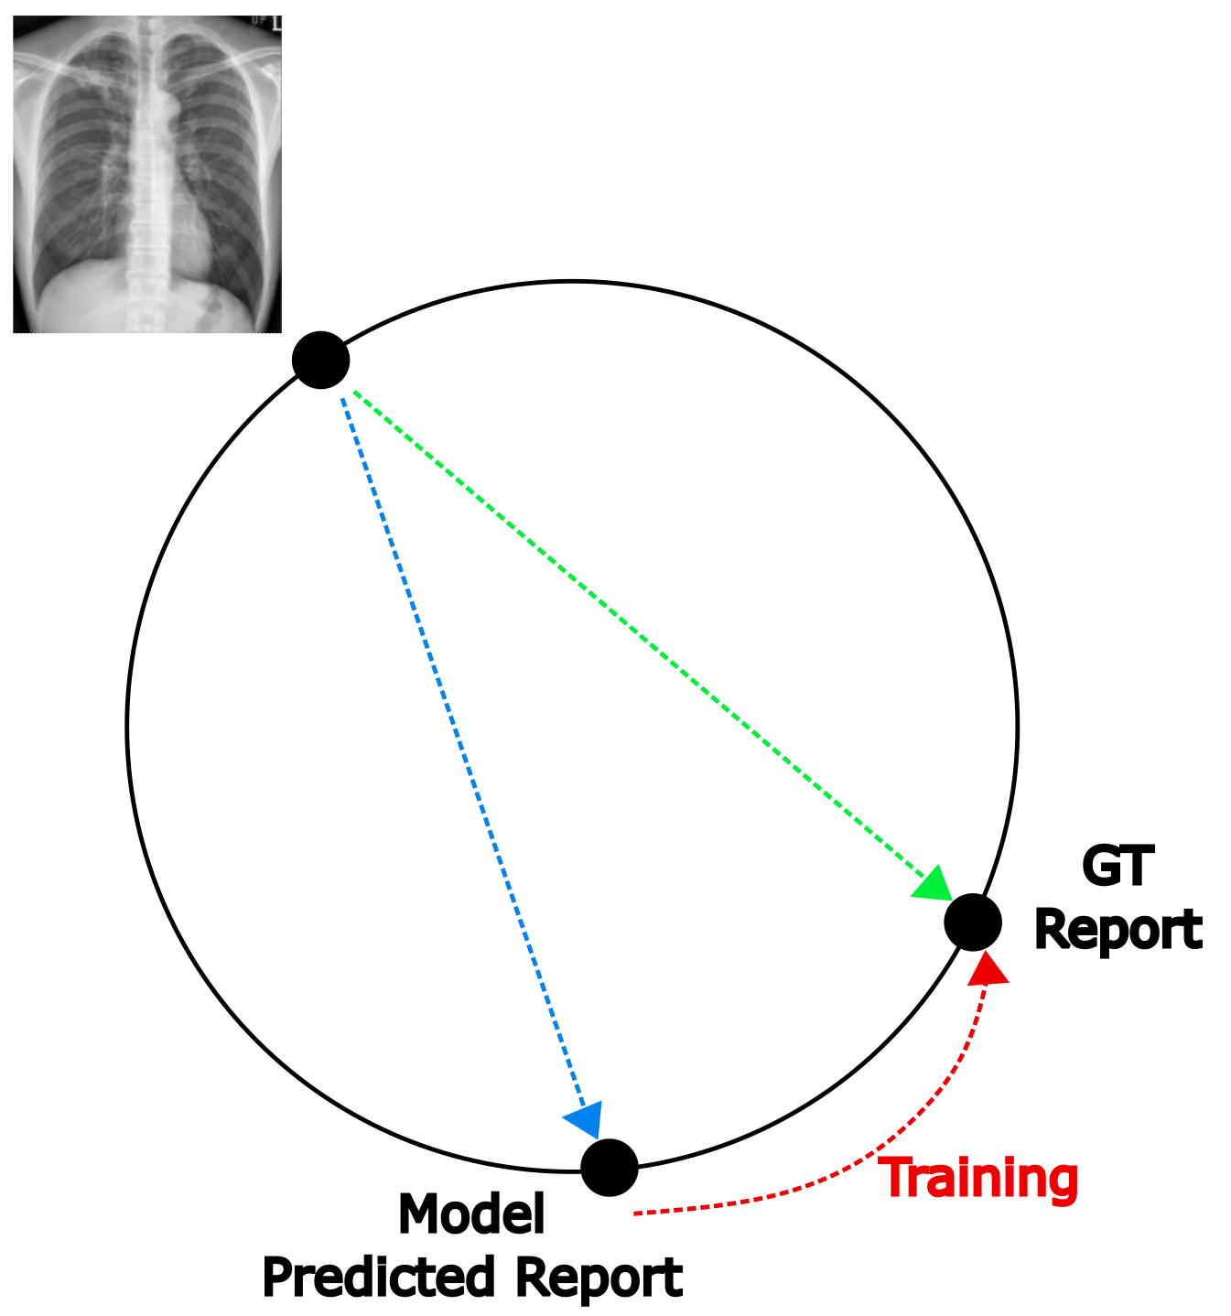
Detail - CLIP directional loss
Apply CLIP directional loss function with pre-trained CLIP model to transformer decoder to enhance accuracy of radiology reports
CLIP directional loss [1] is to steer generative models towards a user-defined text caption CLIP provides a score of how close an image is to a caption
[1] Gal, R., Patashnik, O., Maron, H., Chechik, G., & CohenOr, D. (2021). Stylegan-nada: Clip-guided domain adaptation of image generator

Slide 10
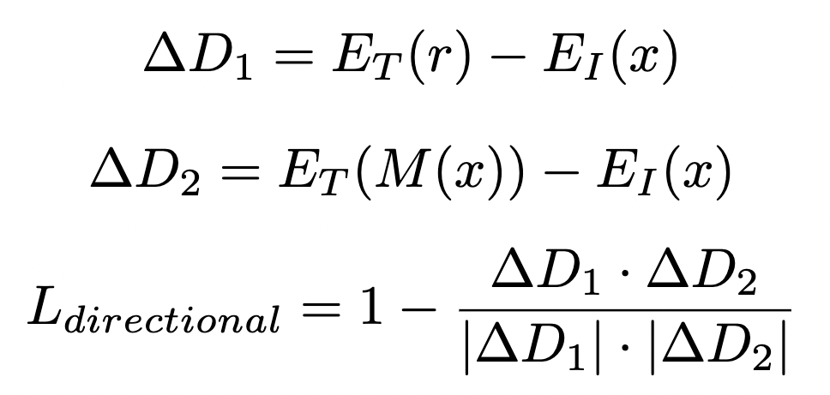

Detail - Loss
Pretrained CLIP's text, image encoder
Learn directional vector,
Directional loss is,
Aligns to,
Report generated from model M
Total loss
Notes:
레포트에 있는 Loss 식 붙여넣기

Slide 11
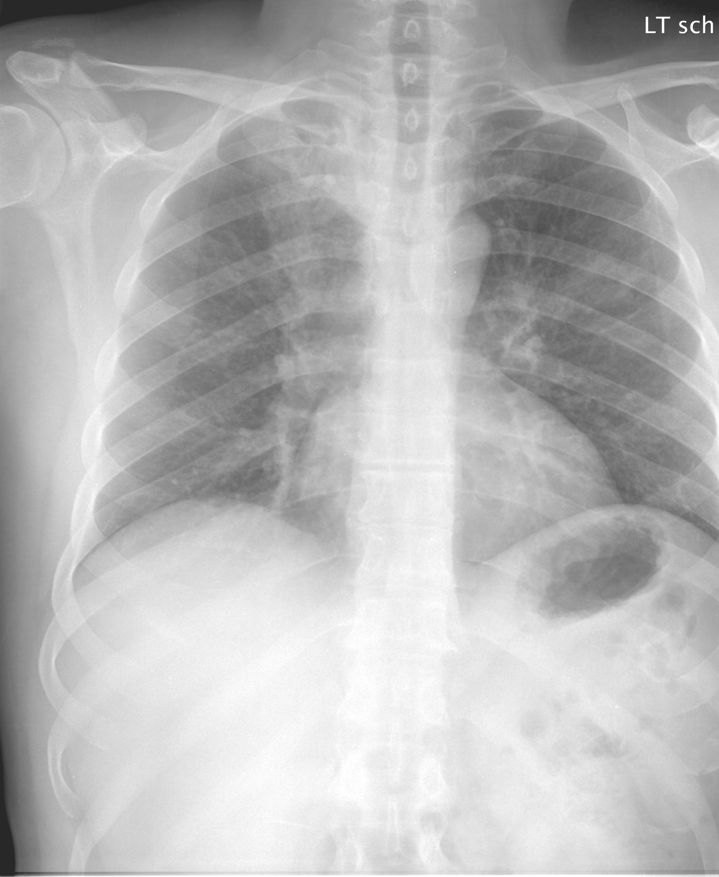
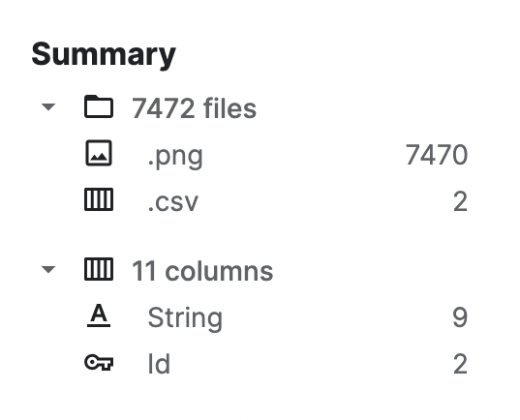
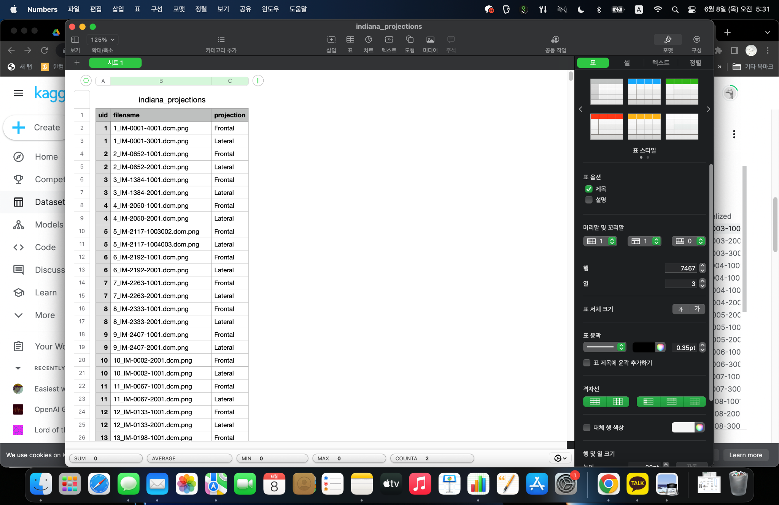
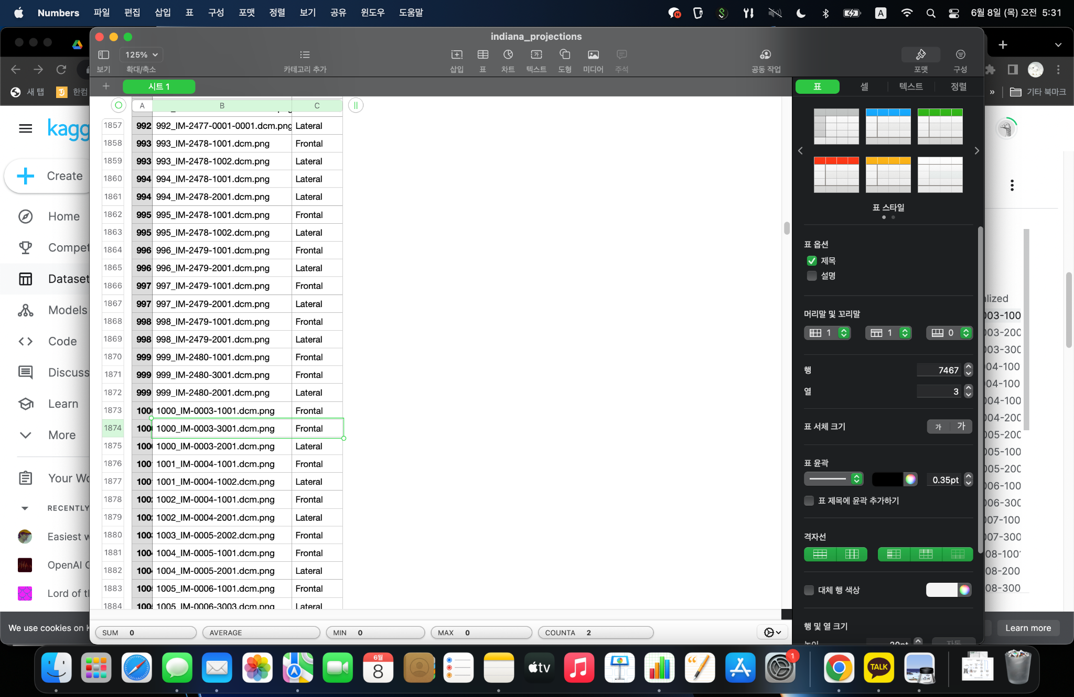
Dataset - IU X-ray
Open access chest X-ray collection from Indiana University
Original images downloaded in raw DICOM standard, converted to png using some post-processing
About 14 GB
Available at:
https://www.kaggle.com/datasets/raddar/chest-xrays-indiana-university
indiana_report.csv
Pneumothorax/apex/right/small;Subcutaneous Emphysema/thorax/right/severe;Subcutaneous Emphysema/neck/severe;Fractures, Bone/ribs/right/anterior/multiple;Airspace Disease/lung/base/right/streaky/mild;Hernia, Hiatal/small;Catheters, Indwelling/thoracic vertebrae;Pulmonary Atelectasis/base/right;Opacity/lung/base/right
Notes:
캡처정리

Slide 12
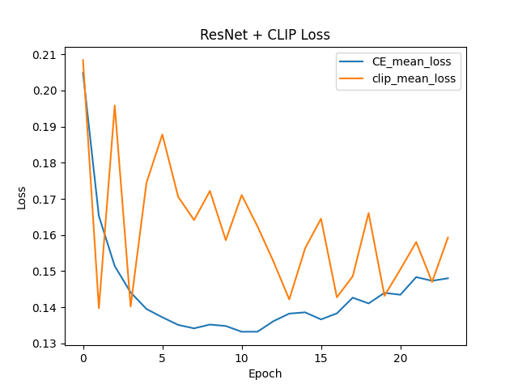
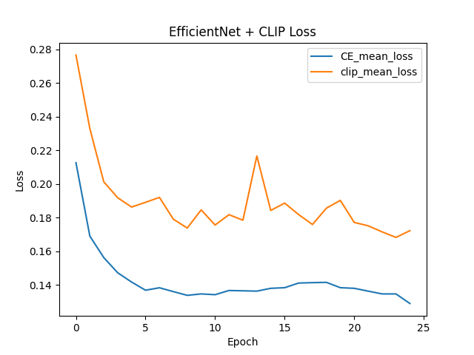
Evaluation & Result
Notes:
레포트에 있는 Loss 식 붙여넣기

Slide 13
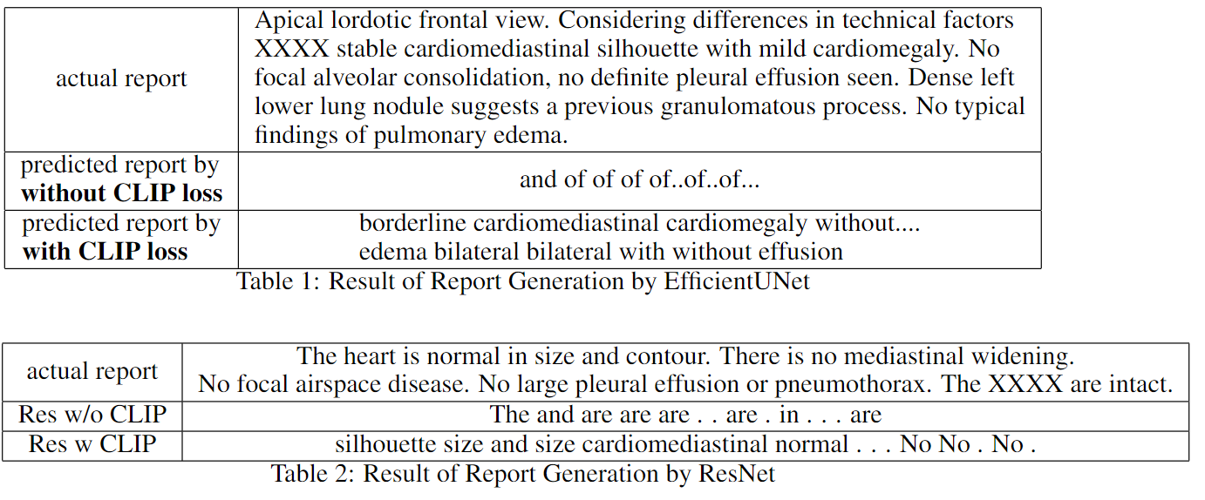
Evaluation & Result
Notes:
레포트에 있는 Loss 식 붙여넣기

Slide 14
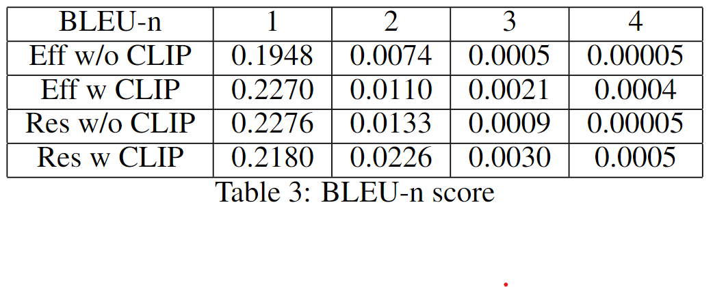
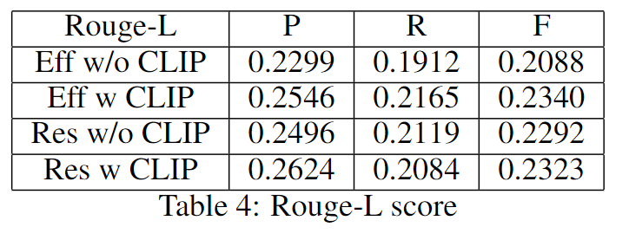
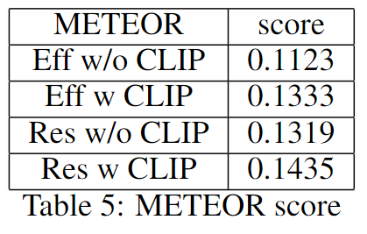
Evaluation & Result
Notes:
레포트에 있는 Loss 식 붙여넣기
3가지 평가지표의 스코어 추가

Slide 15
Conclusion
Unlike our expectation, ResNet encoder showed better performance than pretrained EfficientUNet encoder
CLIP loss increased performance of both models
CLIP loss is more effective with EfficientUNet
The results of the prediction reports confirmed that EfficientUNet may produce better report results

Slide 16
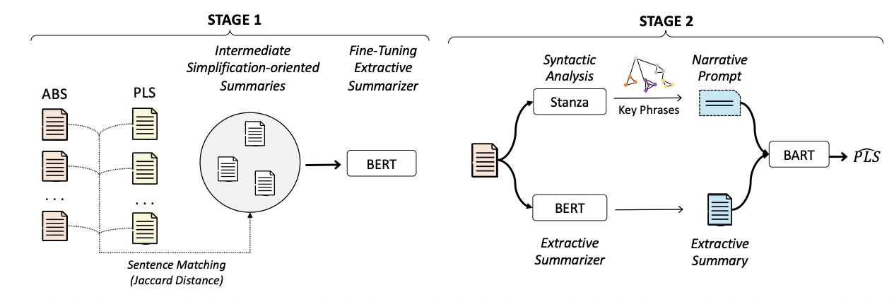
Limitation & Future work
Limitation
Computing Environment
Datasets
Future work
Lu, J., Li, J., Wallace, B.C., He, Y., and Pergola, G. (2023). NapSS: Paragraph-level Medical Text Simplification via Narrative
Prompting and Sentence-matching Summarization
Modify model architecture, find the best Lossfunctions
Text simplification model for medical texts
Baseline model NapSS(Narrative Prompting and Sentence-matching Summarization)
Compare accuracy by replacing word embedding to BioWordVec and med-BERT
X-ray reports for training data

